Slide 1
Student Hub
Team Members:
Vidisha Sawant
Prashant Shinde
Neerav Poriya
Raj Mehta

Slide 2
Project Description
Our aim is to create an agnostic application to help cater needs of international students. Through this application, we try and answer the most common questions and doubts people have in relation to various things like accommodation, opening bank accounts, obtaining SSNs and university events, etc.

Slide 3
User Research methods used
Survey (73 response)
Interview (6 Interviews)
After our survey and communication with other people from the WhatsApp group we received that many candidates faced challenges regarding:
Accommodation
Immunization
Loan process
Health insurance

Slide 4
Demographic Questions
What is your name?
How old are you?
Where are you from?
Do you have work-experience?
Interview Questions

Slide 5
Interview Questions
Are you aware of the application deadlines for the Fall and Spring semesters?
Is your visa approved yet? (Conditional question)
How are you feeling now that you will fly to the United States?
Are you aware of the documents required for the Visa process?
Are you aware of the documents usually required for online applications?
Were you aware of exam-based minimum requirements for the university ( GRE / GMAT / Toefl / IELTS)?
Did you face any challenges coming to the US as an international student?
Are you aware of the money you can carry in cash/forex card/ Bills?
Are you aware of the Insurance?
Do you know about the insurance that is approved by universities other than their own?
What are the challenges that you are facing before coming to USA?

Slide 6
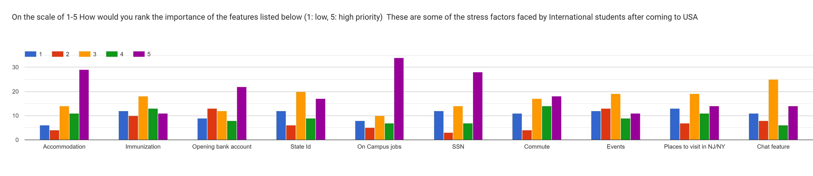
Survey
We carried out survey to get quantitative data and below were our findings:
Upcoming Students:
Most of them were aware about visa process, exams to give and deadlines but faced challenge in the loan process, health insurance and immunization process.
Current Students
High Priority Features ( 5 )
Mentorship program page | 37
On Campus Job | 34
Accommodation | 29
SSN | 28
Opening Bank Account | 22
Mid Priority Features ( 3 )
Chat feature | 25
State Id / License | 20
Places to visit | 19
Events | 19
Immunization | 18

Slide 7
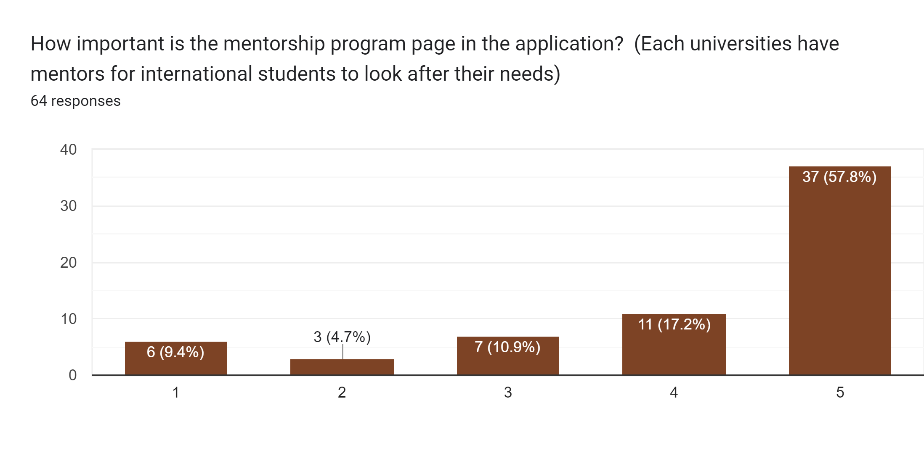

Slide 8

What other features than the ones listed above would you like to see in the application that you think is important?

Slide 9
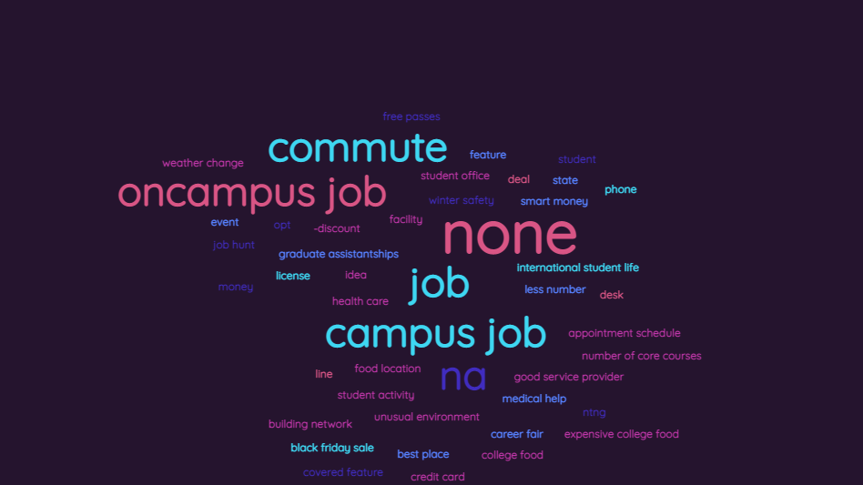

Slide 10
What are the challenges after coming to the USA?

Slide 11
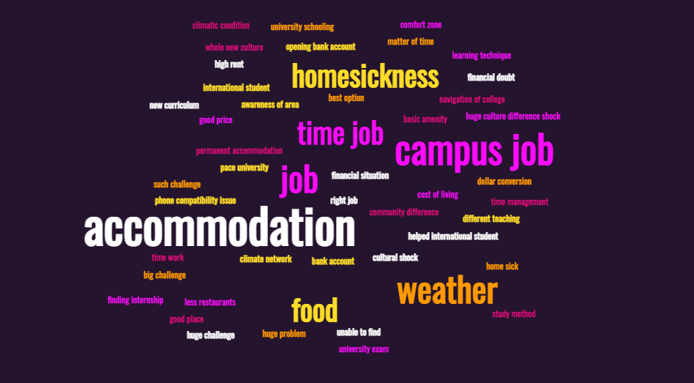

Slide 12
Interview
We conducted 2 interviews in-person for the current students and 5 through messages and audio calls for upcoming students.
Upcoming Students Demographics
Current Students Demographics
Amala Natu
Age | 24
Hometown | Mumbai
Vrushali More
Age | 25
Hometown | Mumbai
Yash Patel
Age | 23
Hometown | Mumbai
Mehul Jikadra
Age | 34
Hometown | Mumbai
Khushbu Nishad
Age | 22
Hometown | Pune
Tushar Verma
Age | 27
Hometown | Thane, Mumbai
Alexander Kamenev
Age | 25
Hometown | Bulgaria

Slide 13
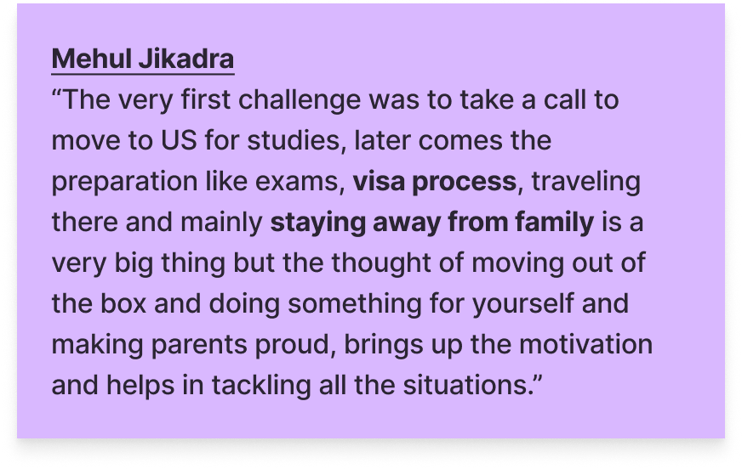
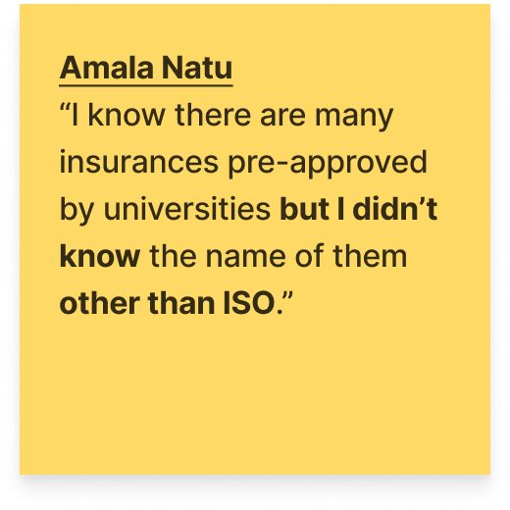
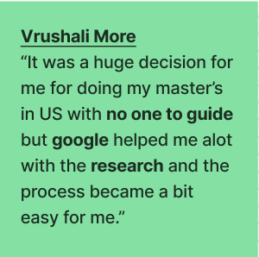
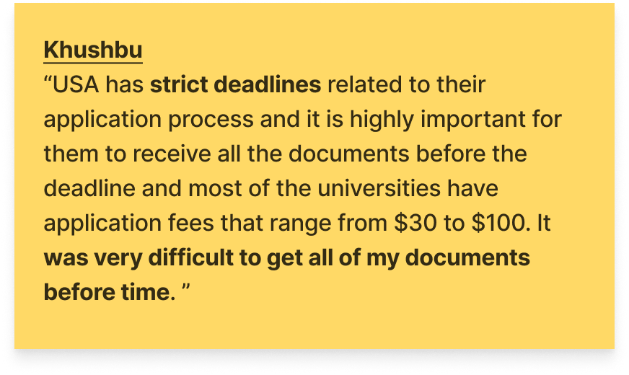
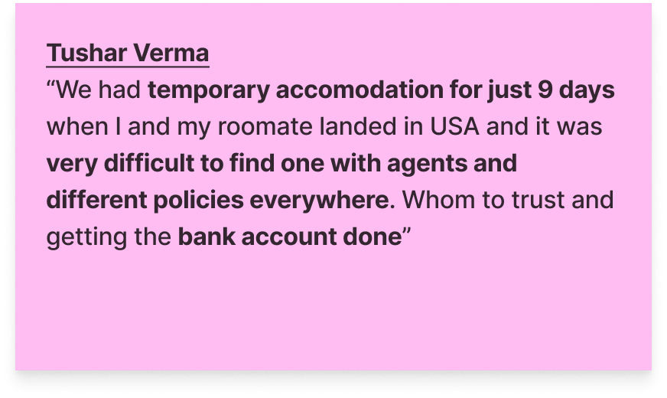
Participant’s original words

Slide 14
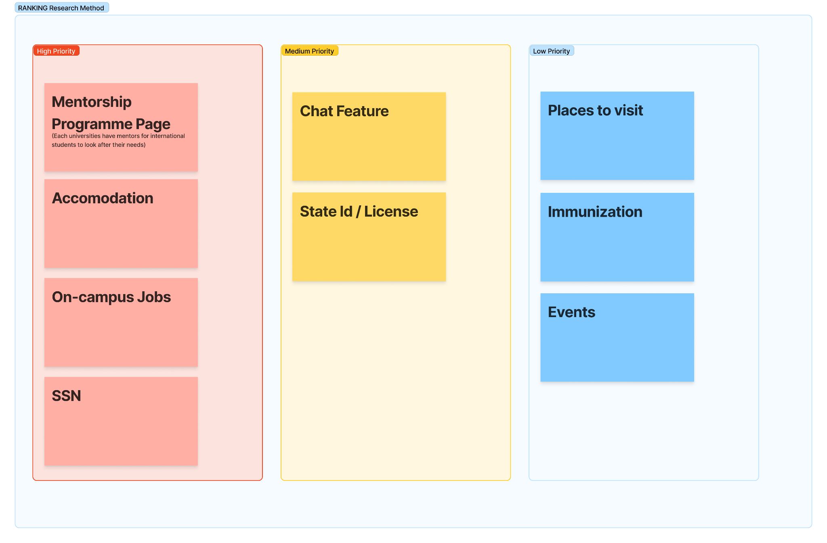
Prioritized User Needs and Features
Based on the Survey and Interviews we conducted we used the Ranking research method to decide on the user features to be provided in the application.

Slide 15

Personas

Slide 16
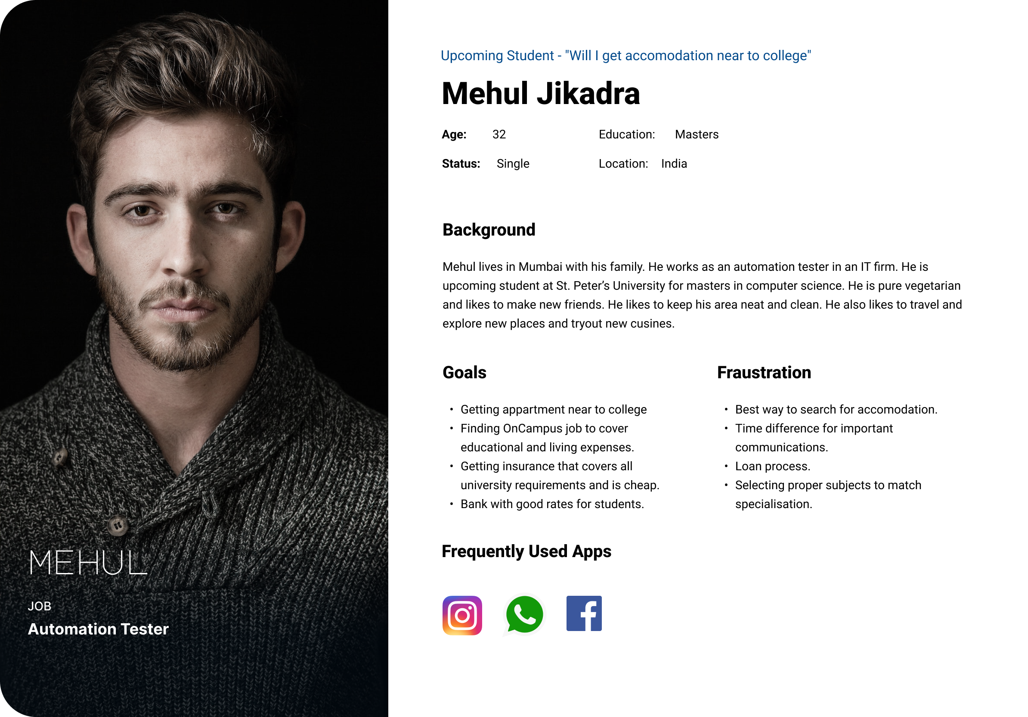

Slide 17
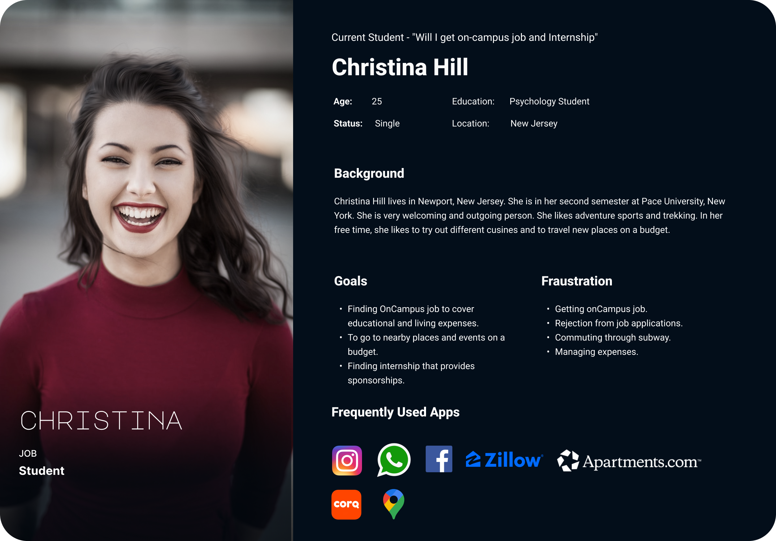

Slide 18
Thank You

